Slide 1
Implement on HAWKEYE Platform Application
Feb. 2019
Name Software Engineering Laboratory Soongsil University

Slide 2
Contents
Unit | Title | Slide#
1 | ###### | 3
2 | ###### | #
3

Slide 3
Unit 1. Object Detection API

Slide 4
Introduction

Slide 5
Steps
2.1. Ready Raspberry PI
2.2. Install TensorFlow
2.3. Compile and install Protobuf Package
2.4. Set up TensorFlow directory structure and the PYTHONPATH variable

Slide 6
2.1. Ready Raspberry PI
PICAMERA
Connect the camera to the raspberry pie and see if it works.
OpenCV
The Object detection scripts use OpenCV. But, this is already installed.

Slide 7
2.2. Install TensorFlow
Code
sudo apt-get install libatlas-base-dev
Tensorflow needs the LibAtlas package. Installed it
pip3 install tensorflow
This code allows you to install tensorflow.
sudo pip3 install pillow lxml jupyter matplotlib cython
This code installs other dependencies that will be used by the TensorFlow Object Detection API.
sudo apt-get install python-tk
Same above.

Slide 8
2.3. Compile and install Protobuf Package
Protobuf Package
The TensorFlow object detection API uses Protobuf, a package that implements Google’s Protocol Buffer data format.
In order to install Raspberry Pie, there is a way to get the code and compile and install it directly.

Slide 9
2.3. Compile and install Protobuf Package
Code
sudo apt-get install autoconf automake libtool curl
First, get the packages needed to compile Protobuf from source.
wget https://github.com/google/protobuf/releases/download/v3.7.0-rc/protobuf-all-3.7.0-rc.tar.gz
Then download the protobuf release from its GitHub repository
tar -zxvf protobuf-all-3.7.0-rc.tar.gz
Unpack the file and cd into the folder. As of 2019-02-12, the most recent version is 3.7.0.
./configure
Configure the build in protobuf-3.7.0-rc
make
Build the package
sudo make install
Install the package

Slide 10
2.4. Set up TensorFlow directory structure and the PYTHONPATH variable
Code
git clone --recurse-submodules https://github.com/tensorflow/models.git
Download the tensorflow repository from GitHub.
export PYTHONPATH=$PYTHONPATH:/home/pi/tensorflow1/models/research:/home/pi/tensorflow1/models/research/slim
Modify the PYTHONPATH environment variable to point at some directories inside the TensorFlow repository. So, add Export line in bashrc
protoc object_detection/protos/*.proto --python_out=.
In research directory, Use Protoc to compile the Protocol Buffer (.proto) files used by the Object Detection API.

Slide 11
Code

Slide 12
4. Result
Testing Model
SSD_Lite model (from the Tensorflow detection model zoo)
The model zoo is Google’s collection of pre-trained object detection models that have various levels of speed and accuracy.
SSDLite-MobileNet model
a model that takes less processing power.
The reason for using the lower performance model is that, Raspberry Pi has a weak processor.
The model run faster
Lower Accuracy

Slide 13
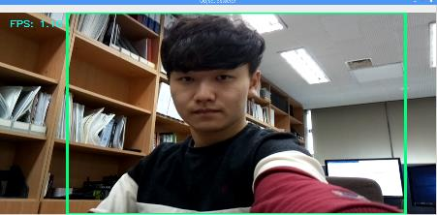
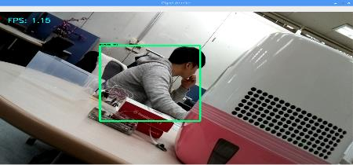
4. Result
Testing
Code
python3 Object_detection_picamera.py
Run code
Test
People Detecting
Figure 1. Detect Person
Figure 2. Detect Person: 94%

Slide 14
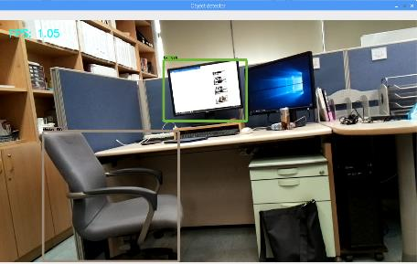
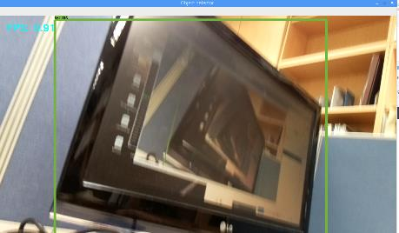
4. Result
Testing
Test
Objects Detecting
Figure 3. Detect Chair and TV : 85% , 67%
Figure 4. Detect TV : 78%

Slide 15
4. Result
Evaluation
Pros

Slide 16
Thank You !

